Slide 1
Networking Basics
An Introduction to Networking

Slide 2
Ice Breaker
Sharing information on a network
Each person is a piece of the network
You will hold a string between you and the next person forming a circle.
An envelope on a binder clip with a slip of paper will be passed along the string directed to one of the classmates
As you get the envelope take it off one string and put it on the next
When the designated person gets the envelope they answer the question then send it back around the string to the person who sent the message.

Slide 3
Network History
Growing up, I was the network in our house...
My friends and I were the neighborhood network...

Slide 4
The Purpose of a Network
Share and/or Consume Information
What type of information do you share?
What type of information do you consume?
Access Network Services
What type of services do you access while at work?
What type of services do you access while at home?

Slide 5
Types of Networks
WAN
Wide Area Network
The Internet
Wireless Area Network
MAN
Metropolitan Area Network
Entire city

Slide 6
Types of Networks
LAN
Local Area Network
Your home network
PAN
Personal Area Network
Bluetooth

Slide 7
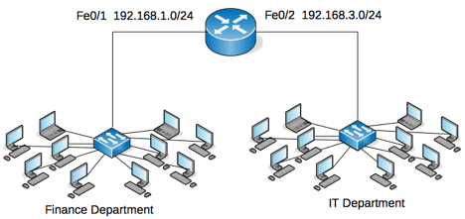
What Are the Parts of a Network?
Router
In network diagrams, routers are round
In reality, routers can be any shape (usually square)
Routers connect networks together

Slide 8
What Are the Parts of a Network?
Switch
In network diagrams, switches are square
In reality, switches are usually square
Switches add connectivity opportunities to a network

Slide 9
What Are the Parts of a Network?
A Medium to Carry Signals
Copper - cheap - what else used copper wires to communicate?
Fiber - glass - expensive
RF Signals - wireless
Any others?

Slide 10
Exercise Time
Identify an Ethernet port, an Ethernet cable, a switch and a router.

Slide 11
The OSI 7 Layer Model
Theoretical Model of Networking
Application
Presentation
Session
Transport
Network
Data
Physical
All People Seem To Need Data Processing
Please Do Not Throw Sausage Pizza Away

Slide 12
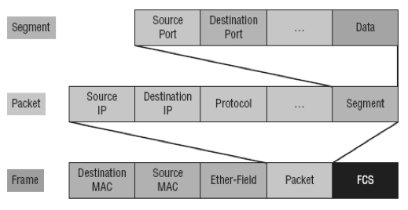
The OSI 7 Layer Model
We only care about the first 4 layers
Transport - flow control, segments, connections,
Network - routers - packets - IP address
Data - switches - frame - MAC address
Physical - network medium - NIC

Slide 13
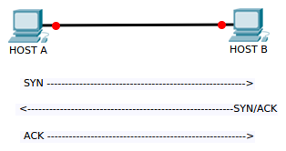
The OSI 7 Layer Model
Transport Layer: Transmission Control Protocol
Connection oriented communication
What services require TCP?

Slide 14
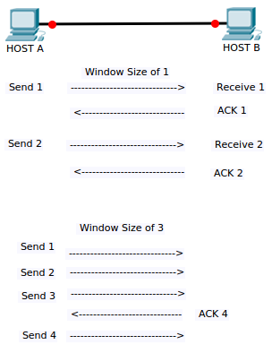
The OSI 7 Layer Model
Transport Layer: TCP Windowing

Slide 15
The OSI 7 Layer Model
Transport Layer: User Datagram Protocol
Not connection oriented
What services require UDP?
Play video
Notes:
https://www.youtube.com/watch?v=VGGmBhARuiY

Slide 16
What Are the Parts of a Network?
Addresses
Communications travel across networks using addresses
Addresses help identify networks
Addresses help identify hosts/systems on networks

Slide 17
What is a MAC Address?
Media Access Control Address
12 character hexadecimal number
MM : MM : MM : UU : UU : UU
The MM sections = Organizational Unique Identifier (OUI)
a4 : 5e : 60 : e8 : b5 : 7a
Also known as the physical address or hardware address
MAC addresses are used with switches

Slide 18
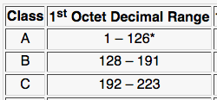
What is an IP Address?
Internet Protocol version 4 Addresses
Look like this: 192.168.1.23
There are approximately 4.3 billion IPv4 addresses
There are classes of IPv4 addresses
We are concerned with class C mostly

Slide 19
What is an IP Address?
Each class has its own private range for LAN use
Private addresses are not routable across the Internet
What layer of the network model uses IP addresses?

Slide 20
What is a Subnet Mask?
Remember our IP address?
192.168.1.23
Part of the IP address indicates the network address
Part of the IP address indicates the host address
The subnet mask number indicates which is which
Example: 255.255.255.0

Slide 21
Exercise Time
To see your address, connect to the wireless network
Open the Command Prompt program
Type: ipconfig /all
Find your addresses on the wireless ethernet adapter
MAC Address (Physical Address)
IPv4 Address
What about the default gateway address?
Any information about the subnet mask?

Slide 22
Exercise Time
Sketch your home network
Router symbol
Wireless router symbol
Switch symbol
What other devices are on your home network?

