Slide 1
Wired Networking Basics
Introduction to Wired Networks

Slide 2
Cabling
Ethernet
Network cables contain 4 twisted pairs of wires
The adapter on the end is an RJ-45
Ethernet cables are limited to approximately 300 feet
Ethernet cable can be shielded (STP) or unshielded (UTP)

Slide 3
Network Hardware
Hub
A Hub divides a connection and speed
Once connection can be used by many hosts
Convenient and cheap
Every port on Hub can see the traffic
Not always allowed on networks because of storms

Slide 4
Network Hardware
Switches
Provide the advertised speed for each port
Traffic is not visible across all ports
Managed: someone has to configure and admin
Unmanaged: use without configuring
Vary in price depending on performance needs
Why would you want managed instead of unmanaged?

Slide 5
Network Hardware
Network Interface Card
A NIC can be wired or wireless
A NIC can have more than one port
Can be fast ethernet 10/100 or gigabit 10/100/1000
Modular: can be removed or can add more
Vary in price depending on needs
Let’s look at some on Amazon or Newegg

Slide 6
Exercise
Participants will connect the laptops to a switch with an Ethernet cable. Students will learn what the lights are for on the switch and the different sections of a switch.

Slide 7
The Firewall
A policy enforcement device
Two basic types of installs
Network based
Physical device on network (Palo Alto, Barricuda)
Host based
Installed on a host (Windows Firewall)

Slide 8
The Firewall
A firewall separates the security domains
Trusted - internal assets, well managed, secure
Untrusted - external, unknown security level, don’t trust
DMZ - your device, somewhat trusted

Slide 9
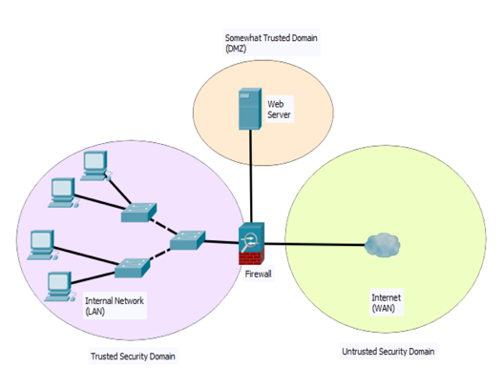
The Firewall

Slide 10
Dynamic IP Addresses or Static IP Addresses
Static
You manually assign to each host
DHCP - Dynamic Host Configuration Protocol
Setup “pools” of IP addresses to be handed out
An IP address is “leased” from the DHCP server

Slide 11
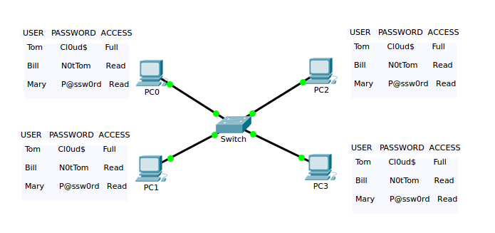
Peer-To-Peer

Slide 12
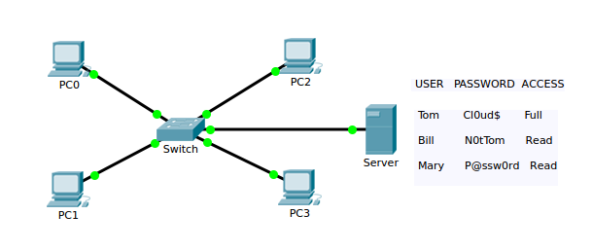
Client-Server

Slide 13
Exercise
Setup the network adapter to a DHCP setting, so the service in the router will give an internal IP address to the NIC.

Slide 14
The Virtual Private Network
Creates a secure connection between 2 end points
Usually a remote worker and the “office”
Can also be between 2 locations (tunnel)
Virtual because the connection route is not dedicated
Private because it’s between you and the “office”

Slide 15
Exercise
Turn off your wireless connection
Set a static IP address for the ethernet card
Connect a cable from your laptop to the switch
Wait for everyone’s switch port light to turn green
Open the Command Prompt program
Issue the ping command against your table mate’s IP address: ping x.x.x.x
Issue the tracert command: tracert 8.8.8.8
After pinging each of your table mates, issue the following:
arp -a

Slide 16
Exercise
Unplug from the switch on your table
Connect to the wireless network
Share your wireless IP address with your table mates
Issue the ping command against your table mates IP address:
ping x.x.x.x
After pinging each of your table mates, issue the following:
arp -a

Slide 17
Exercise
Issue the following command:
ping 127.0.01

