Slide 1
Raspberry Pi Hardware
By: Mike Kwiatkowski

Slide 2
Hardware/Software made simple…
https://www.khanacademy.org/computing/computer-science/how-computers-work2/v/khan-academy-and-codeorg-hardware-and-software

Slide 3
An Introduction
Developed by the Raspberry Pi Foundation in 2011
One goal was to make more computers available in England’s lower grade level classrooms
In turn, create more applicants to Cambridge’s Computer Science program
Hobbyists and enthusiasts saw the potential immediately
The low cost and capability has helped maintain the device’s popularity

Slide 4
The PC’s I’ve known
Exercise!

Slide 5
Hardware Basics
Processor
ARM vs Intel
Memory
Storage
Input/Output
Wired Ethernet
Wireless Ethernet
HDMI
Bluetooth
GPIO
Motherboard

Slide 6
Processors
The “brains” of a computer
Modern processors allow computers to be such flexible tools
Use code to interpret input and process it to output
The code is varied depending up the current function of the device
Processor architecture is the set of instructions burned into the chip to which the software code has access
Two major architectures
Intel x86
ARM (Advanced RISC Machines)

Slide 7
Processors - ARM chips
ARM made by a number of manufacturers
Loose standards between manufacturers
RISC architecture
Low power
Cool running
Powerful enough
Multi-core configurations
Raspberry Pi’s use chips made by Broadcom
Specifically for the R-Pi 3
BCM2837 - ARM Cortex A53 (ARMv8)
1.2Ghz Quad Core

Slide 8
Memory
Volatile
Main system memory - RAM
Fast access and “close” close to processor
Raspberry Pi 3 has 1GB of DDR SDRAM
Non-Volatile
Read Only Memory - ROM
Used for information which doesn’t change
Precursor to Flash memory!

Slide 9
Storage
Non-volatile type of memory
Information is retained when power is removed
Common storage types
Hardrives - mechanical magnetic spinning platters
SSD - Solid State Drive
Optical - CD and DVD drives
Flash drives - USB drives, SD, microSD, compact flash
Raspberry Pi uses either SD or microSD cards

Slide 10
Input and Output
Commonly known as I/O
Allows a computing device to interact with the outside world
A number of different I/O connections exist
The Raspberry Pi typically has
USB
HDMI
Audio ports
Ethernet - wired and wireless in some models
Bluetooth - in newer models!
GPIO - General Purpose Input/Output

Slide 11
Universal Serial Bus - USB
Allows for up to 128 connected devices (!)
Raspberry Pi rev2 and above have 4 USB 2.0 ports
Supports up to 480Mbs
Can increase number of ports by using a USB hub

Slide 12
Video and Audio
Standard HDMI connection for video
Combined stereo audio and composite video connector

Slide 13
Network Connections
Wired Ethernet
R-Pi3 B and lower supports 100Mb connection
R-Pi3 B+ supports 1Gb connection with a maximum throughput of 300Mb
Wireless Ethernet
R-Pi3 is the first Pi to support wireless natively using an onboard Broadcom chip
The initial R-Pi3 supported 2.4GHz only
The R-Pi3 B+ supports 5GHz and 2.4GHz - b/g/n/ac standards
Bluetooth is available in the Raspberry Pi 3 line!

Slide 14
GPIO - General Purpose Input/Output
40 pins which allow input and output controlled through software
Supports input or output of 0V(LOW) or 3.3V(HIGH)
Be certain to consult a pin map before using
Other special I/O features
PWM - Pulse Wave Modulation on certain pins
SPI
I2C
Serial

Slide 15
Motherboard
Makes the connections between components
Adds flexibility to desktop and laptop PC’s
Determines types of initially available connections
Raspberry Pi’s are a SoC
System on a Chip
The board is for connections only

Slide 16
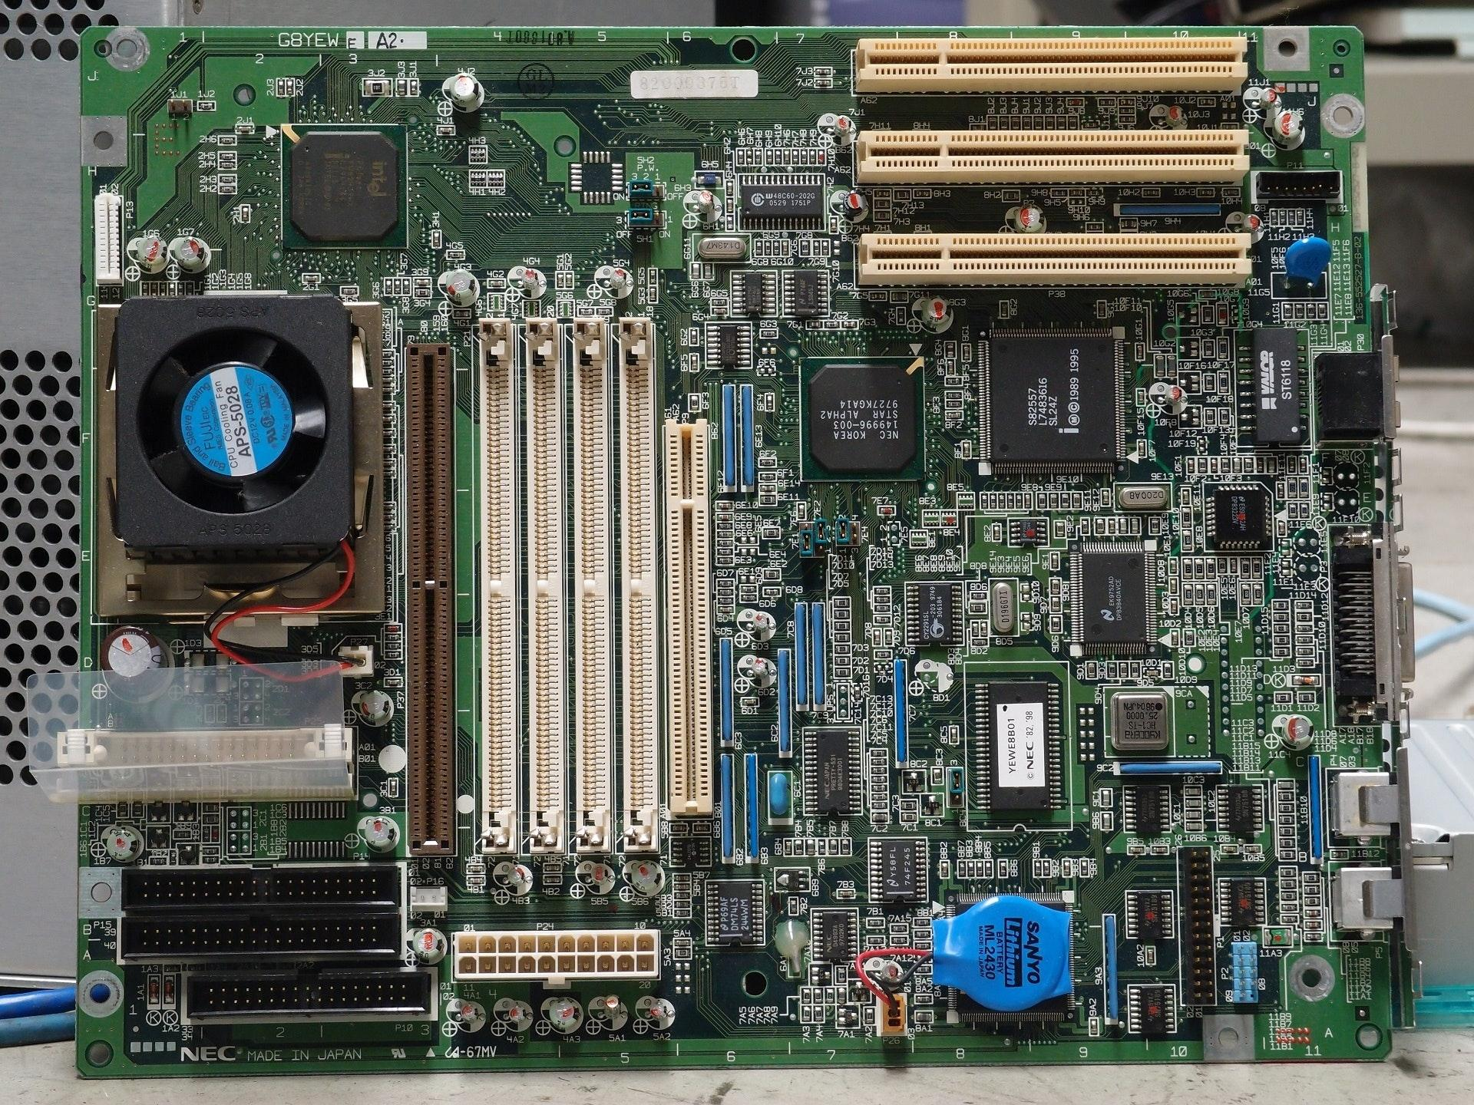
Desktop Motherboard

Slide 17
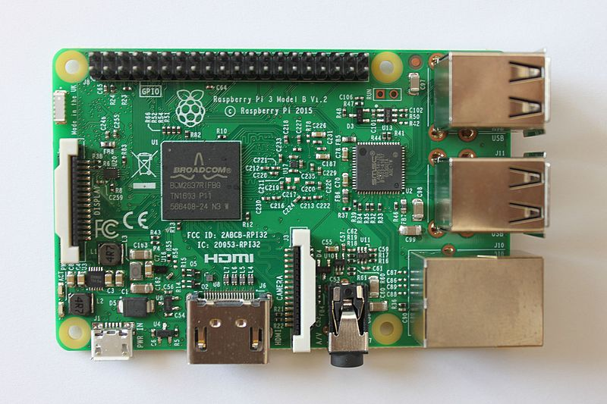
Raspberry Pi 3

Slide 18
Sources
www.raspberrypi.org
Raspberry Pi Hacks, Suehle and Callawway, 2014, O’Reilly

