Slide 1
Setting up a Webcam on a Raspberry Pi
By Mike Kwiatkowski

Slide 2
Cameras Everywhere!
Excercise!
What experience have you had with webcams or other small cameras?

Slide 3
Cameras Everywhere!
Camera electronics have improved greatly
Detection electronics and lense systems are extremely compact
Small cameras are on phones, tablets and laptops
Discrete devices make it difficult to protect privacy

Slide 4
Raspberry Pi Webcam
Requirements for a Pi Webcam
Raspberry Pi
A small camera which attaches by USB or the internal CSI cable
Network connection
An enclosure if you wish to make it discrete
Internet access for configuration software

Slide 5
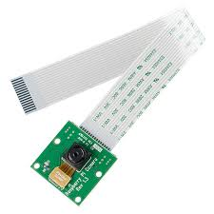
Webcam installation
This discussion assumes the camera with be connected to the CSI connector on the main board of the Pi
Disconnect power and gently connect camera ribbon cable to CSI connector on the board

Slide 6
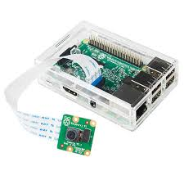
Webcam Installation - Hardware
With cable inserted and anchored with the clip power on your Pi
After boot up open a terminal window

Slide 7
Webcam Installation - OS Preparation
Update Raspbian
sudo apt-get update
sudo apt-get dist-upgrade -y
sudo rpi-update
Check git
git --version
Install if it’s not
sudo apt-get install git-core

Slide 8
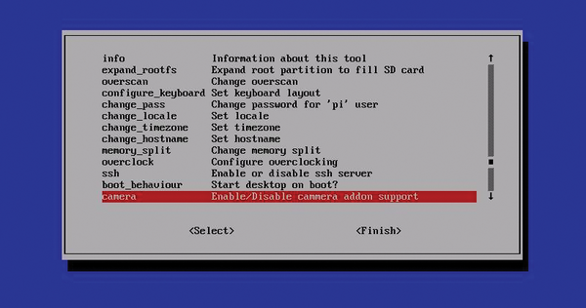
Webcam Installation - OS Configuration
Run Pi configuration
sudo raspi-config
From the menu find the camera entry
Hit enter and enable the camera
Exit configuration
Reboot your Pi

Slide 9
Webcam Installation - Testing Camera
After the reboot open a terminal window
Test your camera by issuing either raspistill or raspivid
raspistill -o test.jpeg
raspivid -o test.H264 -t 30000
If you camera works on to the next step!

Slide 10
Webcam Installation - Software Installation
Grab software from git repository
git clone https://github.com/silvanmelchior/RPi_Cam_Web_Interface.git
Make installer executable
cd RPi_Cam_Web_Interface
chmod u+x *.sh
Start installation
./RPi_Cam_Web_Interface_Installer.sh

Slide 11
Webcam Installation - Configure Installation
Choose Apache web server for installation
Let installation finish
Run script again and choose configure
Notice that you can modify user access in this menu option
Exit configure menu
Start the RPi Cam process

Slide 12
Webcam Installation - Test Webcam!
The starting of the service should now have your Pi listening on port 80
This will allow browsers to connect!
Test it by opening a browser and going to
http:\\127.0.0.1\
You should now be seeing your webcam!
You can go to other student’s devices by entering their IP address instead of your own

Slide 13
So why are we worried?
Inexpensive hardware and a little bit of time can put a camera anywhere
Newest Pi’s have wireless built-in
(3D design software or Thingiverse) + 3D printer = you can create a case to hide your webcam in plain site

Slide 14
Resources
www.raspberry-pi-geek.com
Using the RPi Cam Web interface
Working with the Raspberry Pi camera module

