Slide 1
GenCyber
Day 1

Slide 2
Online Ethics

Slide 3
Learning Objectives
Explain ethical behavior
Provide examples of integrity
Explain importance of ethical behavior in cyber security
Explain the difference between black hat, gray hat, and white hat hackers
Explain the difference between a professional tester and a hacker

Slide 4
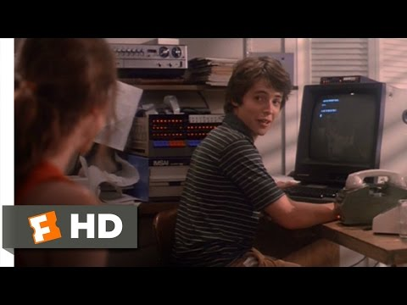

Slide 5
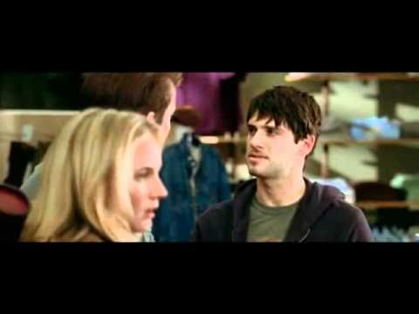

Slide 6
Discussion
Differences in hacking between these two movies
Does that make an ethical difference
Notes:
Look for modern day examples of ethical dilemmas in movies, TV, etc. 1 it gets their attention, 2 forces them to look at it through a whole new lens. That is important as ethics often go out the window when everyone else is doing it...

Slide 7
Discussion
Give some other examples of security clearances you have seen in TV/movies. What do you think they mean?
Acceptable Use Policy - how is it distributed, enforced etc.

Slide 8
Classroom Use Policy
Within groups, come up with a list of 5 items you use or would like to use in your classroom to enforce online security

Slide 9
Ethics
What do you think digital ethics means?
“Digital ethics is making moral decisions online, like not using the internet to cheat”

Slide 10
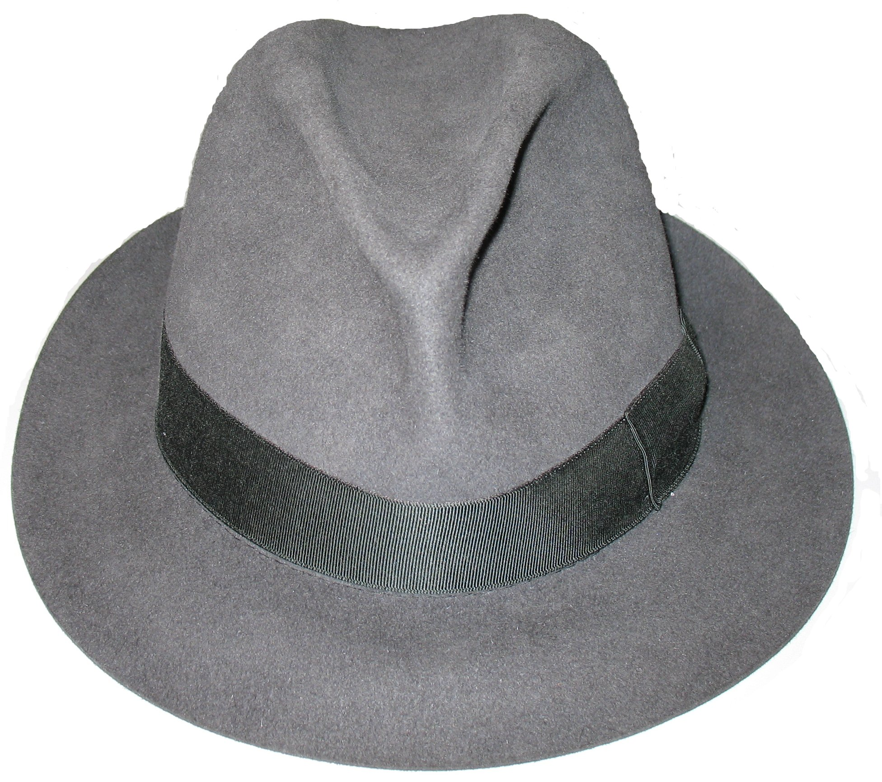
Types of Hackers
People who break in to cause harm to a computer or network
Computer hacker or security expert who may violate laws or typical ethical standards, but does not have malicious intent
People who specialize in hacking to check the faults in the system
https://en.wikipedia.org/wiki/Grey_hat

Slide 11
Clearance Levels
Confidential
Secret
Top Secret
https://www.state.gov/m/ds/clearances/c10977.htm#4
https://www.cyberdegrees.org/resources/security-clearances/
Losing your clearance:
https://news.clearancejobs.com/2014/08/23/guidelines-revoking-security-clearance/

Slide 12
Confidential
Confidential is the basic level of clearance (many military personnel have it). It means you will have access to material that could cause measurable damage to national security if it were disclosed.
Confidential clearances require a thorough background check, including verification of your criminal, education and employment records. Immediate relatives and spouses/partners will be screened. Fingerprint and credit checks are common.
Confidential clearances are reinvestigated every 15 years.

Slide 13
Secret
Secret is one step up from Confidential. You will be dealing with material that could cause grave damage to national security if it were disclosed.
The background check covers the same bases as a Confidential clearance.
Secret clearances are reinvestigated every 10 years.

Slide 14
Top Secret
Top Secret is the highest clearance issued. It means you will have access to information that could cause disastrous damage to national security if it were disclosed.
The background check is supplemented by a field check, a Single Scope Background Investigation (SSBI) and possibly a polygraph test. Your foreign travel and assets with be scrutinized. Your employers, co-workers, neighbors and other references will be interviewed.
Top Secret clearances are reinvestigated every 5 years.
What’s more, if you’re working on highly sensitive programs, a.k.a. Special Access Programs, you’re going to need additional clearances.

Slide 15
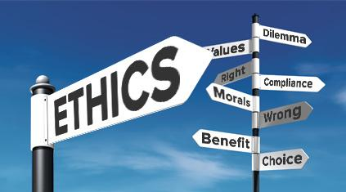
Ethical Choices you make now COULD impact jobs you qualify for down the road

Slide 16
10 Commandments of Computer Ethics
1. Thou shalt not use a computer to harm other people.
2. Thou shalt not interfere with other people's computer work.
3. Thou shalt not snoop around in other people's computer files.
4. Thou shalt not use a computer to steal.
5. Thou shalt not use a computer to bear false witness.
6. Thou shalt not copy or use proprietary software for which you have not paid.
7. Thou shalt not use other people's computer resources without authorization or proper compensation.
8. Thou shalt not appropriate other people's intellectual output.
9. Thou shalt think about the social consequences of the program you are writing or the system you are designing.
10. Thou shalt always use a computer in ways that ensure consideration and respect for your fellow humans.
http://computerethicsinstitute.org

Slide 17
Netiquette
Netiquette is a term created to describe proper etiquette on the Internet
Think before you write! Ask yourself: "Would I say that to their face?" or "Would I say that in front of my mom?" If something upsets you, wait at least 24 hours before responding. Avoid using all capital letters. Try using symbols to show emphasis instead. Use emoticons to show expression, but don't get too carried away. They will help others interpret your meaning. Take the time to proofread, spell check, and send the right impression of yourself.
http://edtech2.boisestate.edu/weltys/502/netiquette.html

Slide 18
Computer Ethics Cases
In the 2010 Roger Corey Bonsant case, Bonsant, then a 17-year-old high school student, was arrested and charged with criminal defamation after he was accused of creating a fake Facebook page using a teacher’s name and image. While the case is still being decided, this is an example of criminal ramifications that students may face for participating in dubious online acts.
In 2011, a 12-year-old Seattle girl was arrested and charged with cyberstalking and first-degree computer trespassing. Authorities alleged that she stole a former friend’s Facebook password, logged into the account and posted explicit content. She was found guilty and sentenced to probation.
Six Nevada middle-schoolers were arrested in January, 2011 for using Facebook to invite other students to take part in “Attack a Teacher Day.” They were all arrested and charged with communicating threats, as several specific teachers were called out in posts to the Web site.
http://www.educationworld.com/a_lesson/lesson-plan-booster/cyber-ethics.shtml

Slide 19
What about my First Amendment Rights?
“Even if speech is protected by the First Amendment, it still can result in criminal charges. Speech that is eligible for First Amendment protection is free from government interference; however, a person who feels harmed by someone’s speech may certainly file charges (such as criminal defamation or harassment) against the “speaker.” (You may want to note that laws vary by state in terms of the specific charges that can be filed in various situations.) Even if the accused is found not guilty, other negative consequences are likely to include a publicly announced arrest, embarrassing media stories and significant legal expenses.”

Slide 20
Choices and Cheaters
http://www.nsteens.org/Comics/ChoicesAndCheaters

Slide 21
Worksheet

