Slide 1
Cyberbullying and CyberSafety

Slide 2
Lesson Objectives
Explain several symptoms of cyberbullying
List several sources for cyberbullying help
Explain tasks that can be performed if cyberbullying is discovered
Explain the culture change that needs to occur
Explain situations to avoid
Explain actions that help personal cyber security
Demonstrate good social media cyber hygiene

Slide 3
Cyberbullying

Slide 4
Discussion
Is bullying as prevalent as the media would have us think or is just a case of kids being mean? What’s the difference?

Slide 5
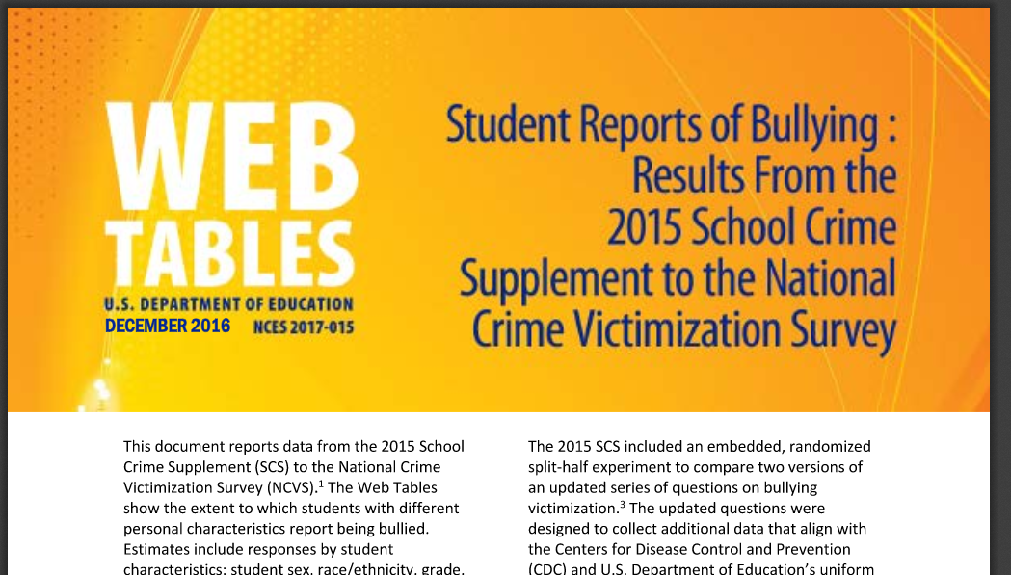
Cyber Bullying
Estimated 21% of students between the ages of 12-18 experience bullying
https://nces.ed.gov/pubs2017/2017015.pdf

Slide 6
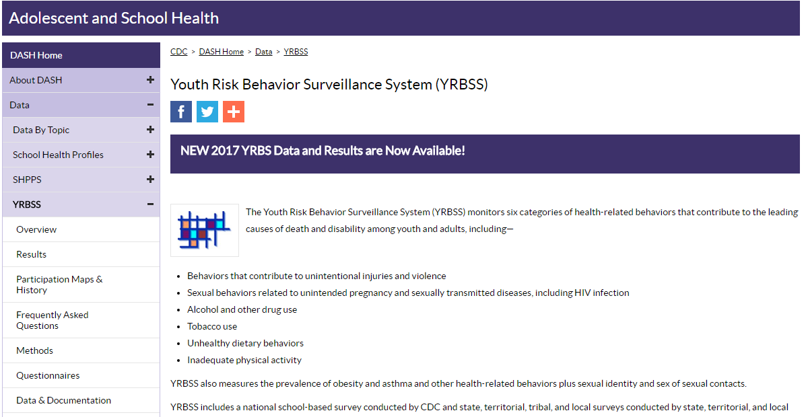
Cyber Bullying
“YRBSS tracks 6 health risk behaviors that contribute to the leading causes of death and disability among youth and adults”
“YRBSS includes a national school-based survey conducted by the CDC and local education and health agencies”
https://www.cdc.gov/healthyyouth/data/yrbs/index.htm

Slide 7
Cyber Bullying

Slide 8
Cyber Bullying
The difference today: cyberspace and social media
According to StopBullying.gov
Persistent
Permanent
Hard to Notice

Slide 9
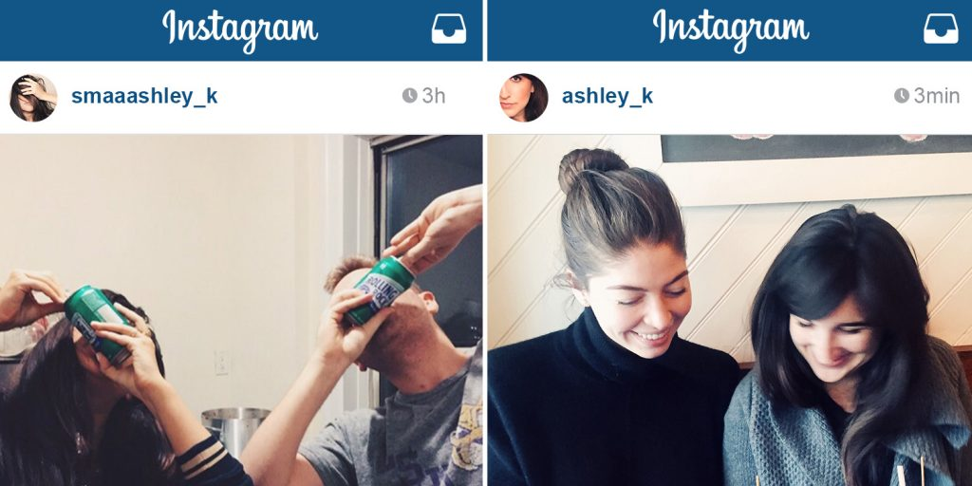
Cyber Bullying: Symptoms
Increase/decrease in technology use
Emotional response to events on their device
Student hides device when other enter area and is reluctant to talk about their current activity on their device
New social media accounts created and old ones are decommissioned [Finsta]
Student begins avoiding social situations...even ones they enjoyed in the past.

Slide 10
Cyber Bullying: What to do
Recognize any changes in behavior
Talk with student, try to find out what happened and who was involved
Document, document, document...take screenshots if necessary
Make contact-contact administration, app developers, possibly the police
Support student as much as possible

Slide 11
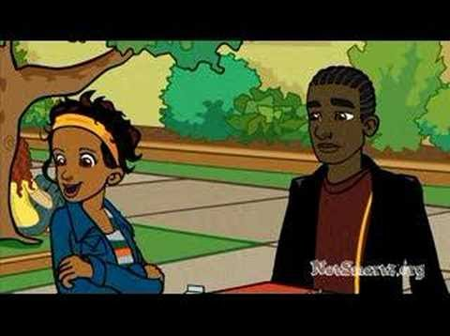
CyberBullying Scenario

Slide 12
Terrible tEXt Worksheet

Slide 13
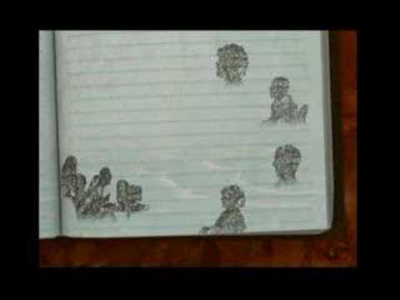
Broken Friendship

Slide 14
Broken Friendship Worksheet

Slide 15
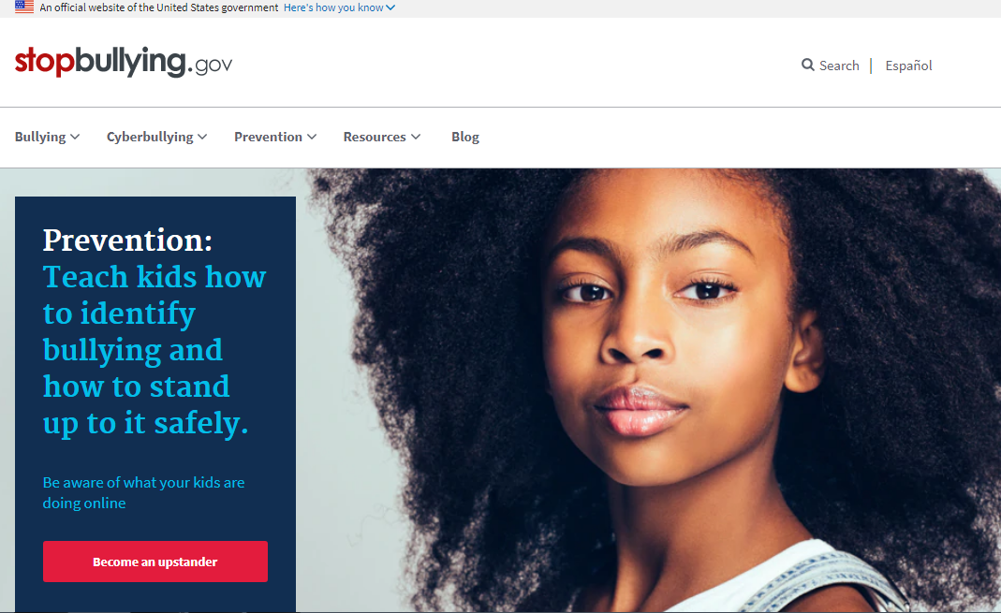
Cyber Bullying Resources

Slide 16
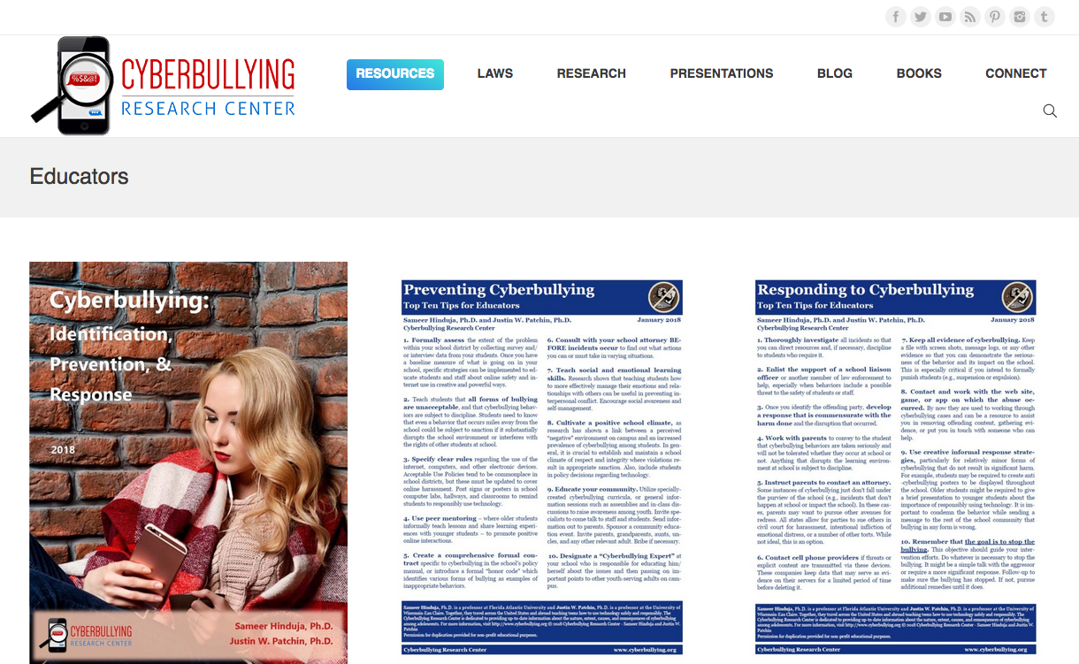
Cyber Bullying Resources
https://cyberbullying.org/

Slide 17
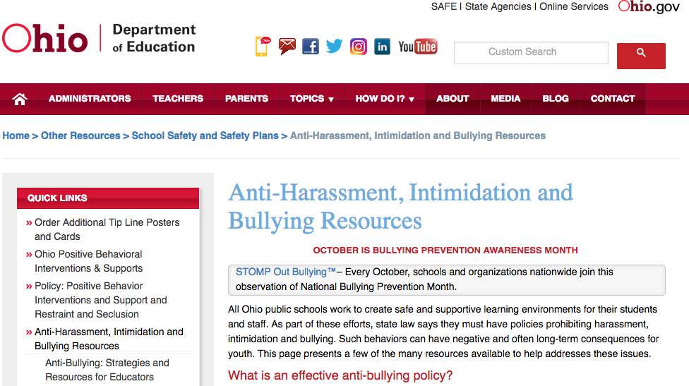
Cyber Bullying Resources
https://education.ohio.gov/Topics/Other-Resources/School-Safety/Safe-and-Supportive-Learning/Anti-Harassment-Intimidation-and-Bullying-Resource

Slide 18
CyberSecurity

Slide 19
Cyber Security: Technology and People
If you think technology can solve your security problems, then you don't understand the problems and you don't understand the technology. — Bruce Schneier
Notes:
Customer expectations is a conversational segway into corporations and breaches for the next slide

Slide 20
Cyber Security: A Culture Change
How many wear a seatbelt now?
How many lock doors before leaving house?
Do you scan a downloaded file before opening?
What is the difference between .xlsx and .xlsm
Do you lock your screen when you walk away?
Notes:
Customer expectations is a conversational segway into corporations and breaches for the next slide

Slide 21
Why Cyber Security is Important
Compliance
FERPA
Cyber Insurance
Auditors
Reputation
Notes:
Customer expectations is a conversational segway into corporations and breaches for the next slide

Slide 22
Suggested Cash Only (Reputation?)
Target
Home Depot
K-Mart
Neiman-Marcus
Dairy Queen
Jimmy Johns
UPS Stores
Sheplers Western Wear
Goodwill (cc vendor)
Supervalu / Albertson (twice)
Bartell Hotels Chain
P.F. Chang

Slide 23
Things To Always Avoid
Let family/friends use company PC
Connect your own devices to work PC
Downloading non-work related content
Connect personal device to company network
Stop answering those “20 questions about you” polls on social media!
Notes:
* bad practices and how their data can get intercepted.

Slide 24
Things To Do
Lock PC when you walk away
Lock file cabinets/desks/doors
Use secure passwords you can remember (phrases, etc)
Use https when possible
NEVER give anyone your password
IT will never email you asking for password
Keep antivirus software up to date
Notes:
things they can do to be more secure

Slide 25
Don’t Just Open it!

Slide 26
Elementary Lesson

Slide 27
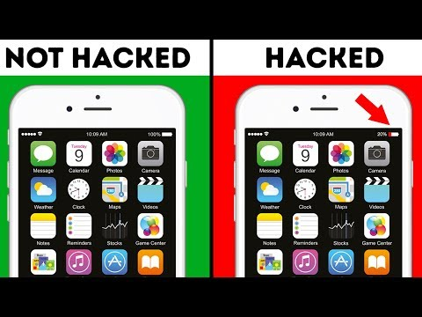
Yes, Your Phone Can Also be Hacked

