Slide 1
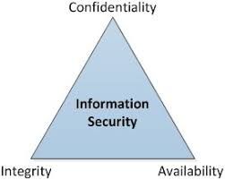
Confidentiality
Integrity
Availability
The CIA triad of cyber security
The 3 tenets of cyber security

Slide 2
Discussion
At your school, what prevents a student from changing their grades?

Slide 3
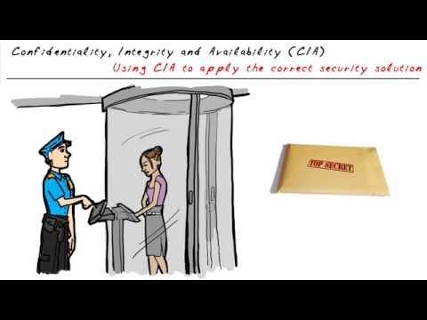
CIA - Overview

Slide 4
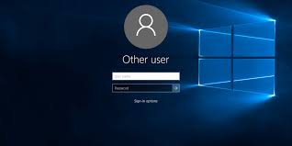
Confidentiality
Protect asset from unauthorized access.
Access to an asset is usually based upon job role or function.

Slide 5
Integrity
Ensuring an asset is not altered
The source of the asset is genuine

Slide 6
Paper Airplane Demo

Slide 7
Availability
An asset is accessible when authorized individuals need it

Slide 8
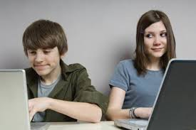
How do we maintain confidentiality?
Access Controls (physical)
Encryption
Shoulder surfing

Slide 9
How do we maintain integrity?
For data assets, we use hashes
A hash value is a numeric value of a fixed length that uniquely identifies data. Hash values represent large amounts of data as much smaller numeric values, so they are used with digital signatures. You can sign a hash value more efficiently than signing the larger value. Hash values are also useful for verifying the integrity of data sent through insecure channels. The hash value of received data can be compared to the hash value of data as it was sent to determine whether the data was altered.
https://docs.microsoft.com/en-us/dotnet/standard/security/ensuring-data-integrity-with-hash-codes

Slide 10
How do we maintain availability?
Fault tolerance (RAID-Redundant Array of Independent Disks)
Redundancy (failover)
Contingency plan

Slide 11
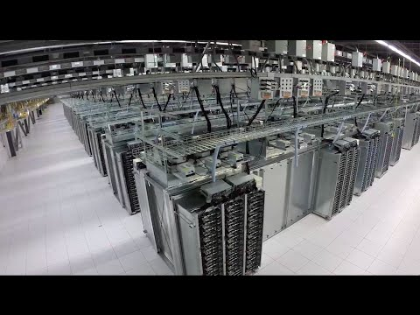
How Does Google Do This?

Slide 12
Name that tenet….
You are presenting a new topic to your class. You arrive to school 10 minutes early to make sure your laptop will communicate with the AV equipment. You open your laptop only to see it begin an OS update process.
Notes:
Availability

Slide 13
Name that tenet….
You are working on a Saturday to enter grades for the semester. To start the process, you open your English 1 spreadsheet.. You suddenly realize the “Deployment Check Sheet” spreadsheet is corrupted.
Notes:
Integrity

Slide 14
Name that tenet….
On Friday, before leaving work for the weekend, against your own best judgement, you check your email one last time. Upon reading your latest email, you realize your student teacher has accidentally emailed a copy of your students grades to the Toledo Blade.
Notes:
Confidentiality

Slide 15
Name that tenet….
Your web server is swamped with incoming requests. In fact, so many requests, the server can’t respond. Your customers are calling to complain they are receiving time out error messages when visiting your web site.
Notes:
Availability

Slide 16
Name that tenet….
John decides to get away from the school in order to get some work done. John visits the local coffee shop. The coffee shop offers good coffee, good snacks, and free wi-fi.
Unknown to John, someone in the coffee shop has been able to take over his communication with the coffee shop’s wifi router. John’s laptop now believes the other person’s laptop is the wifi router.
Notes:
integrity

