Slide 1
Types of Cyber Attacks

Slide 2
Phishing
Normally appears as an email from an established business or entity
Aimed at a very wide audience
Asks for personal information, password reset, attached file (malware), or malicious link
Usually includes social engineering tactics

Slide 3
Spear Phishing
Specific type of phishing, usually aimed at a specific target or group
Appears as an email from a trusted sender
Often includes a component of social engineering

Slide 4
Network Probe
This is an attempt to gain access to a computer through weak points in the computer network or system.
Computer / Network

Slide 5
Brute-Force
Essentially guessing a password until successful to gain access to a computer, web site, DB, etc.
A-Z 26 characters
a-z 26 characters
0-9 10 characters
!@#$;,. 33 characters
Total of 95 characters
Available characters raised to the power of the password length
8 character password = 95 ^ 8 = a little over 6.6 quadrillion

Slide 6
Brute-Force - continued
High end video cards (for gaming) can be used to guess passwords
Approximately 10 billion hash guesses a second
Approximately 889,920,000,000,000 guesses per day
95 ^ 8 would take approximately 7.5 days to guess

Slide 7
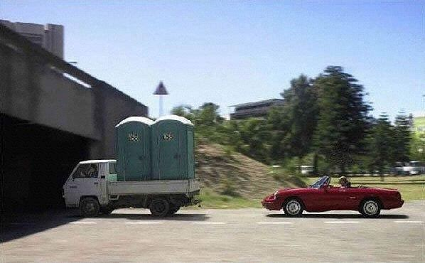

Slide 8
Man In The Middle
An attacker places themselves between you and a trusted Internet source. You believe you are connected to the trusted Internet source. The trusted Internet source believes it is connected to you.
Popular example is the hoodie wearing loaner at the coffee shop….the one trying not to draw attention to themselves, yet has a ton of stickers on their laptop.

Slide 9
Adware
“Free” software might include adware
The developer of the free software makes money from the ads
Adware may alter your browser settings (new toolbars, new home page), track your browser usage, and/or display ads specific to your habits

Slide 10
Spyware
Similar to adware, except you don’t know the spyware is installed
Used to track your Internet habits
Could be used to capture key strokes, screen shots, and/or web form data

Slide 11
Ransomware
Once installed on your system, it encrypts your data
You must pay a ransom (bitcoin) to decrypt your data
Would you pay? How much would you pay?
You’re only as good as your last data backup

Slide 12
Distributed Denial of Service
Overwhelming a service with traffic from multiple sources – making it unusable.

Slide 13
Trojan Horse
A software program that appears to be legitimate software
Once installed, it performs other tasks like:
Installing other bad software
Exfiltrate data from your computer
Turn your computer into part of a Denial of Service attack

Slide 14
Virus
Attached to another file or program
Requires an action to run
Can replicate itself to other systems by attaching to documents or files

Slide 15
Worm
An application that can replicate itself without human action
Can replicate to other computers without attaching to documents or files
Usually used to modify or delete files on the infected system

Slide 16
Examples

Slide 17
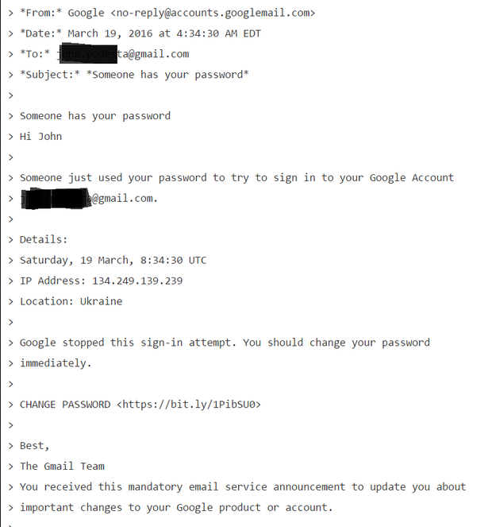

Slide 18
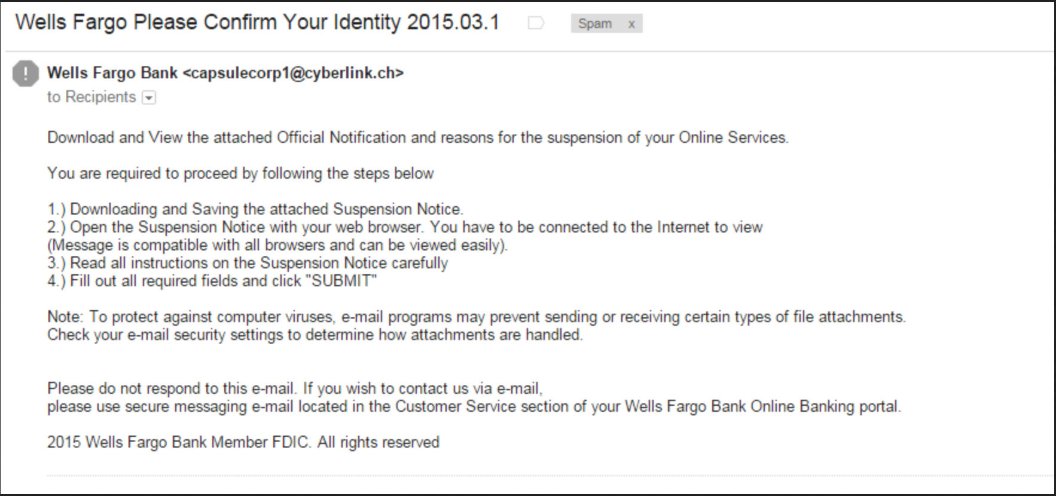

Slide 19
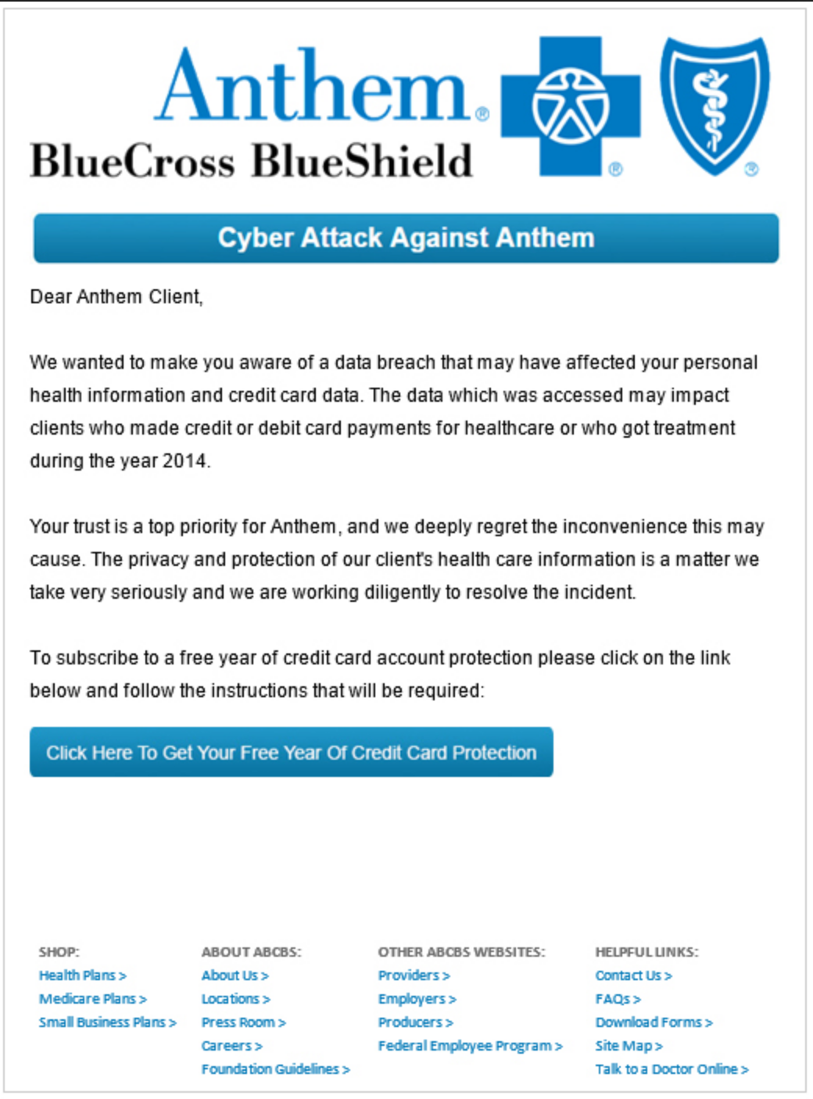

Slide 20
The Morris Worm - 1988
Robert Tappan Morris
“Research” to find the scale/size of the Internet
Robert made a miscalculation and it ran wild
Was facing a 5 year sentence and $200k fine
Received 3 years probation and $10k fine
Now works at MIT

Slide 21
Target
HVAC contractor clicked a link in an email
Infection was able to pivot to Staples network
Target stores were all 1 giant network, easy to pivot to other stores

Slide 22
Get Up To Date on Current Threats
https://www.mcafee.com/enterprise/en-us/threat-center.html
https://www.symantec.com/security-center/threats
https://www.ted.com/talks/mikko_hypponen_fighting_viruses_defending_the_net

