Slide 1
Security Issues within Social Media

Slide 2
Learning Objectives
Explain the purpose of the different social media platforms
Explain social media data privacy best practices
Explain the End User License Agreement
Demonstrate Social Media Best Practices

Slide 3
Discussion
At your tables, come up with the top 5 items students do on social media that are dangerous

Slide 4
Platforms
Facebook
Twitter
Instagram
Whisper
Kik
SnapChat
LinkedIn
YouTube

Slide 5
What is Whisper?
Beware:
Whisper
Yik Yak
Kik
Rumr

Slide 6
Teen Usage - US (August 2017)
https://www.statista.com/statistics/250176/social-network-usage-of-us-teens-and-young-adults-by-age-group/

Slide 7
6 Degrees of Information

Slide 8
Digital Footprint
The traces you leave behind on sites you visit
Opinions
Interests
Activities
Photos

Slide 9
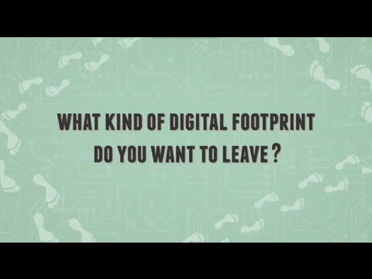
Digital Footprint

Slide 10
Is Your Email Part of a Data Breach?
https://haveibeenpwned.com/

Slide 11
EULA/Terms of Service
Outlines:
What data is collected
How they protect your data
Who can see your data

Slide 12
Privacy Settings

Slide 13
Best Practices
Don’t post about vacations
Don’t post pics with identifying background information
Metadata
Don’t answer the 20 question surveys
Check privacy/security settings on social media

Slide 14
Sample Settings

Slide 15
Risks
Inappropriate content. Most social media sites have rules about what's OK to post, but there may still be sexual, violent, illegal or other types content you don't want children to see.
Cyberbullying. Some children and teens may make cruel comments to or about their peers on social media. Social media sites where people can post anonymously make cyberbullying especially easy.
Identity thieves. Children and teens may share personal information, leaving them open to identity theft, scams or hacking.
Sexting. Some teens and children may share nude or partially nude images through social media apps and face academic, social, or even legal consequences.
Online predators. Pretend to be someone else, groom child and convince them to send inappropriate content or meet in person.

